Slide 1
Finding Hill Gradients Using FOSS
Dave Barter - CEO
Nautoguide Ltd.
dave@nautoguide.com @citizenfishy

Slide 2
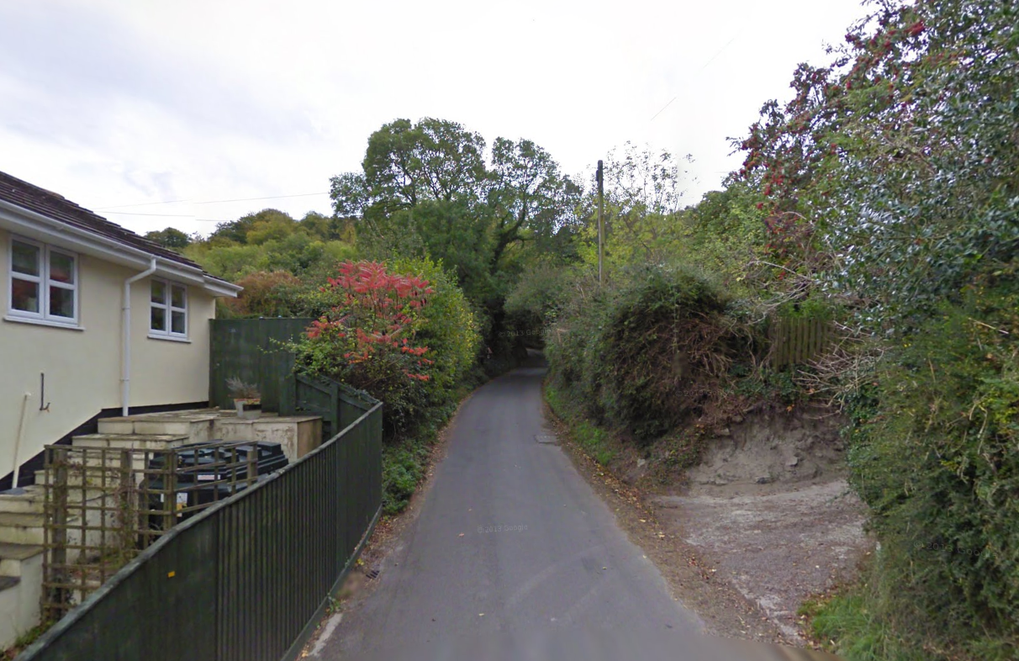
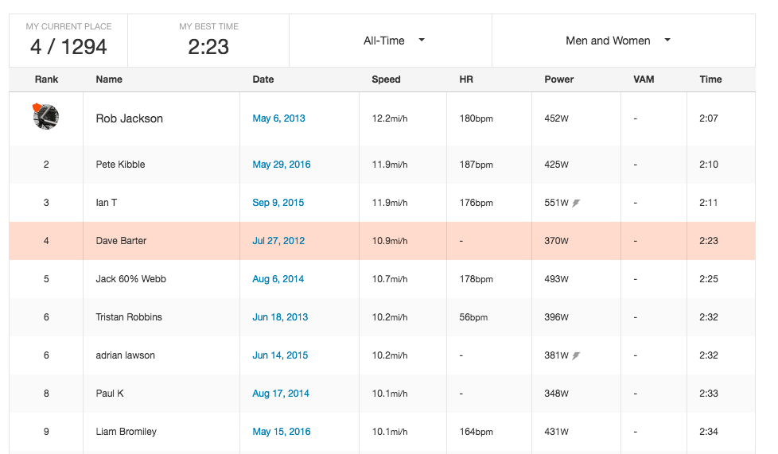
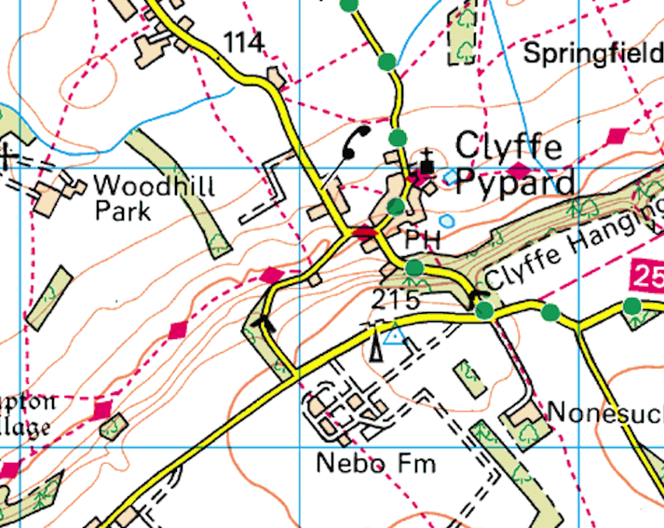
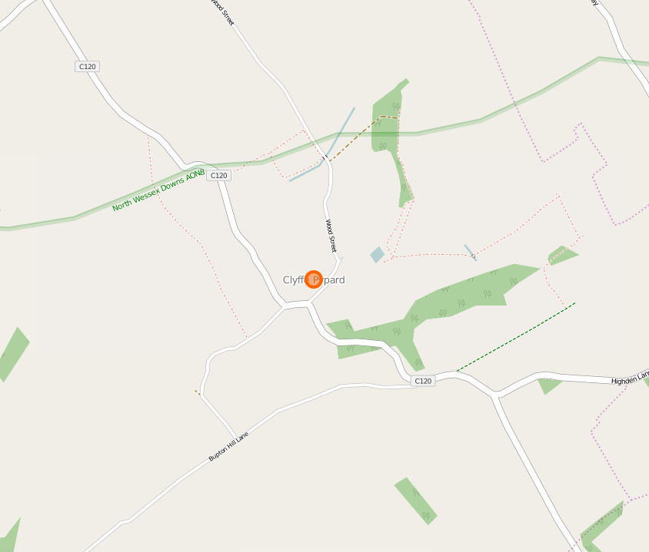
Clyffe Pypard
Notes:
Fanatical cyclist
Strava segment
Where are the gradient chevrons?
Where are the contours?
This map just does not do it for a fanatical cyclist like me. I spend time looking for Chevrons which tell me where all the best hills are

Slide 3


Methodology
Source height data
Add Z values to road line strings
Find and categorize gradient markers
Sensibly add to map
Notes:
OSM data has lost the elevation from GPX traces

Slide 4
Adding Z-Values to Road Linestrings
EA LIDAR data
ASTER DEM
SRTM
Let’s see the code
Notes:
Show GPX layer as perfect world example of what we are trying to achieve
DEM data sources
LIDAR data looked good as high resolution but did not cover Clyffe Pypard
The first version of the ASTER GDEM, released in June 2009, was generated using stereo-pair images collected by the ASTER instrument onboard Terra. ASTER GDEM coverage spans from 83 degrees north latitude to 83 degrees south, encompassing 99 percent of Earth's landmass.
SRTM The new data have been released with a 1 arc-second, or about 30 meters (98 feet), sampling that reveals the full resolution of the original measurements.
How to add height to linestring SHOW FUNCTION
How to write plugin in QGIS to show the profile

Slide 5
Adding Z-Values to Road Linestrings Using Contours
H1
Height = H1 + D1/(D1+D2) x (H2 –H1)
D1
H2
D2
Let’s see the code
Notes:
Contours have the resampling done for you
Can use OS Terrain 50 data set or create your own from DEM using OGR tools

Slide 6
View in QGIS
QGIS does not fully support Z values
profileViewer plugin
Time for some hackery
Let’s see the code
Let’s see it in action

Slide 7
Calculate Gradients
Gradient
Azimuth
Road segment + 1
Classify
dY
Let’s see the code
dX

Slide 8
Distribute gradients
17
12
14
Let’s see the problem
12
Let’s see the code

Slide 9
Improvements
Fully OSM compliant version
Combine DEMs to increase accuracy
Better road traversal algorithm
https://github.com/nautoguide/gradient_markers

Slide 10
Finding Hill Gradients Using FOSS
Dave Barter - CEO
Nautoguide Ltd.
dave@nautoguide.com @citizenfishy

